Slide 1
Older People’s Housing Strategy
Haringey Patient Participation Groups Network Meeting
17 February 2025

Slide 2
Background
In early stages of developing a new Older People’s Housing Strategy, spanning a 15-year period.
N.B. By “older people”, we are referring to people aged 50+.
Why now?
Commitment brought forward in Housing Strategy 2024-29
Ageing population
Current housing stock not meeting the needs of many older residents
Issues related to older people’s housing feed into wider housing crisis
Notes:
Older = 50+

Slide 3
Strategic Context
Strategy will cover housing provided by:
Haringey Council
Specialist providers
Housing associations
Private rented sector
Private market for owner occupiers
Strategy will consider the different roles that the Council takes on.
Notes:
Council’s many roles, incl as a social landlord, developer, planning authority, provider of adult social care (including aids and adaptations), and commissioner of other services.

Slide 4
Process
Two phases of engagement and co-design:
Wider engagement (Nov 2024 – Mar 2025)
Co-design of strategy through working groups (Mar – Apr 2025)
Consultation on draft strategy (Oct – Nov 2025)

Slide 5
Timeline
Nov 2024 – Mar 2025 | Wider engagement + working group recruitment
Mar – Apr 2025 | Working groups meet
Apr – Sept 2025 | Draft writing overseen by internal steering group
Sept 2025 | Cabinet agrees draft strategy for consultation
Oct – Nov 2025 | Formal consultation on draft strategy
Dec 2025 | Strategy agreed and adopted by Cabinet

Slide 6
How can I get involved in the development of the Older People’s Housing Strategy?

Slide 7
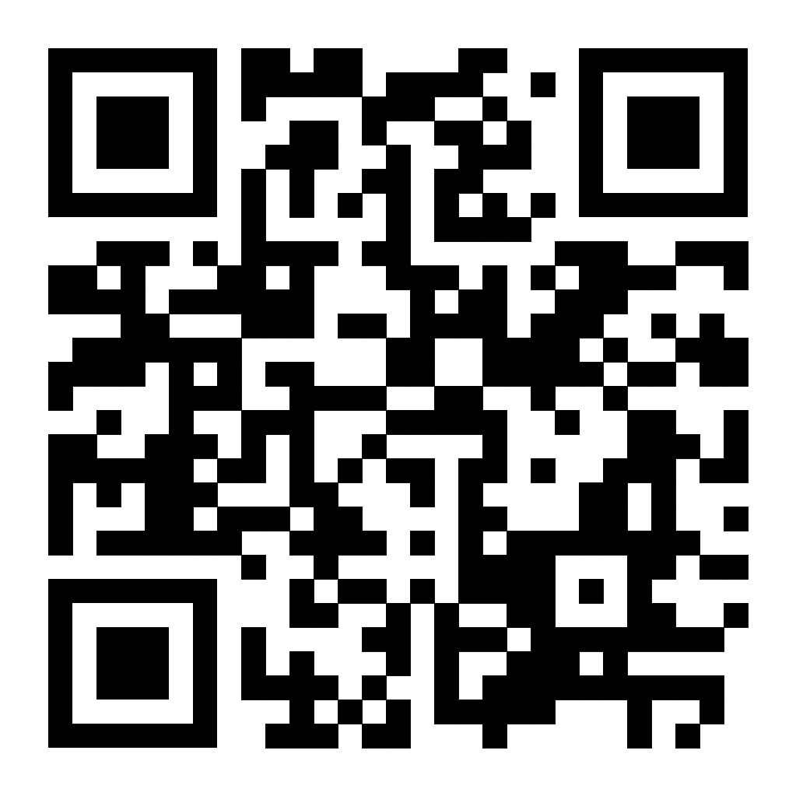
Commonplace Engagement Surveys
We want to hear from you!
Four surveys:
General – for people aged 45+
For professionals (e.g. GPs)
For carers under 45
For carers aged 45+
Surveys close on Sunday 16th March 2025
Notes:
We want to hear from you – share your thoughts and insights by answering one of our surveys [explain for surveys + closing date]
Please scan the QR code to open our engagement site and respond to one of our surveys – I will also put the link in the chat (https://olderpeopleshousingstrategy.commonplace.is/)
We would also appreciate you sharing the link with your family, friends and neighbours in Haringey. Your feedback is crucial in helping us to improve housing options for older people across Haringey over the next 15 years

Slide 8
Working Groups
Criteria
Haringey resident aged 50+
When?
Between late-March and April 2025
How long?
90 minutes
Reimbursement
£20 voucher
Sign-up form closes on Sunday 9th March 2025
Notes:
You can sign-up to join one of our 3 WGs, which will feed further into the development of the OPHS
The WGs will meet between late-March and April. Each WG will have 6 participants and will run for 90 minutes.
We will provide each participant with a £20 voucher for their time and expertise, along with light refreshments at each meeting.
If you are interested in joining a working group, please scan the QR code and complete the sign-up form – I will also put the link to the form in the chat (https://forms.office.com/e/zV9U05fHmK)
We particularly encourage sign-ups from people who are ethnically minoritised, disabled, LGBTQ+ and/or do not own their own home, as we want to ensure that diverse voices help to shape the strategy, so that it can take into account the range of lived experience of OP in Haringey
Please make sure you sign up by Sunday 9th March

